Slide 1
UTA Event Mapper
Team 10
Mason Jeff Omar

Slide 2
Github
https://github.com/Omarkjee/eventmap-3311

Slide 3
Project Overview
Our project goal is to create a website for UTA students, faculty and visitors to host, find and share events on campus.
We believe this can improve social outreach for organizations and individuals.

Slide 4
Current Progress
Account Creation
  Create and sign into an account stored in firebase database
Event creation and viewing
  Smoothly transition between viewing upcoming and ongoing events or hosting your own event
Interactive map
  Find events on your route and navigate the website with an interactive map

Slide 5
Feedback & Adjustments
Remove Friends List
Feedback suggests the friends list feature may not be necessary.
We plan to replace it with a simpler "Share This Event" button, which will generate a shareable URL linking to the website and the event.
New Features to Consider
  Center Map Button: Add a button that quickly centers the map, improving navigation.
  Categories: Implement event categories for easier sorting and discovery.
  Bound Map: Set boundaries to prevent the map from drifting too far out of view.
  Language Filter: Foster a safe environment with an inappropriate language filter.

Slide 6
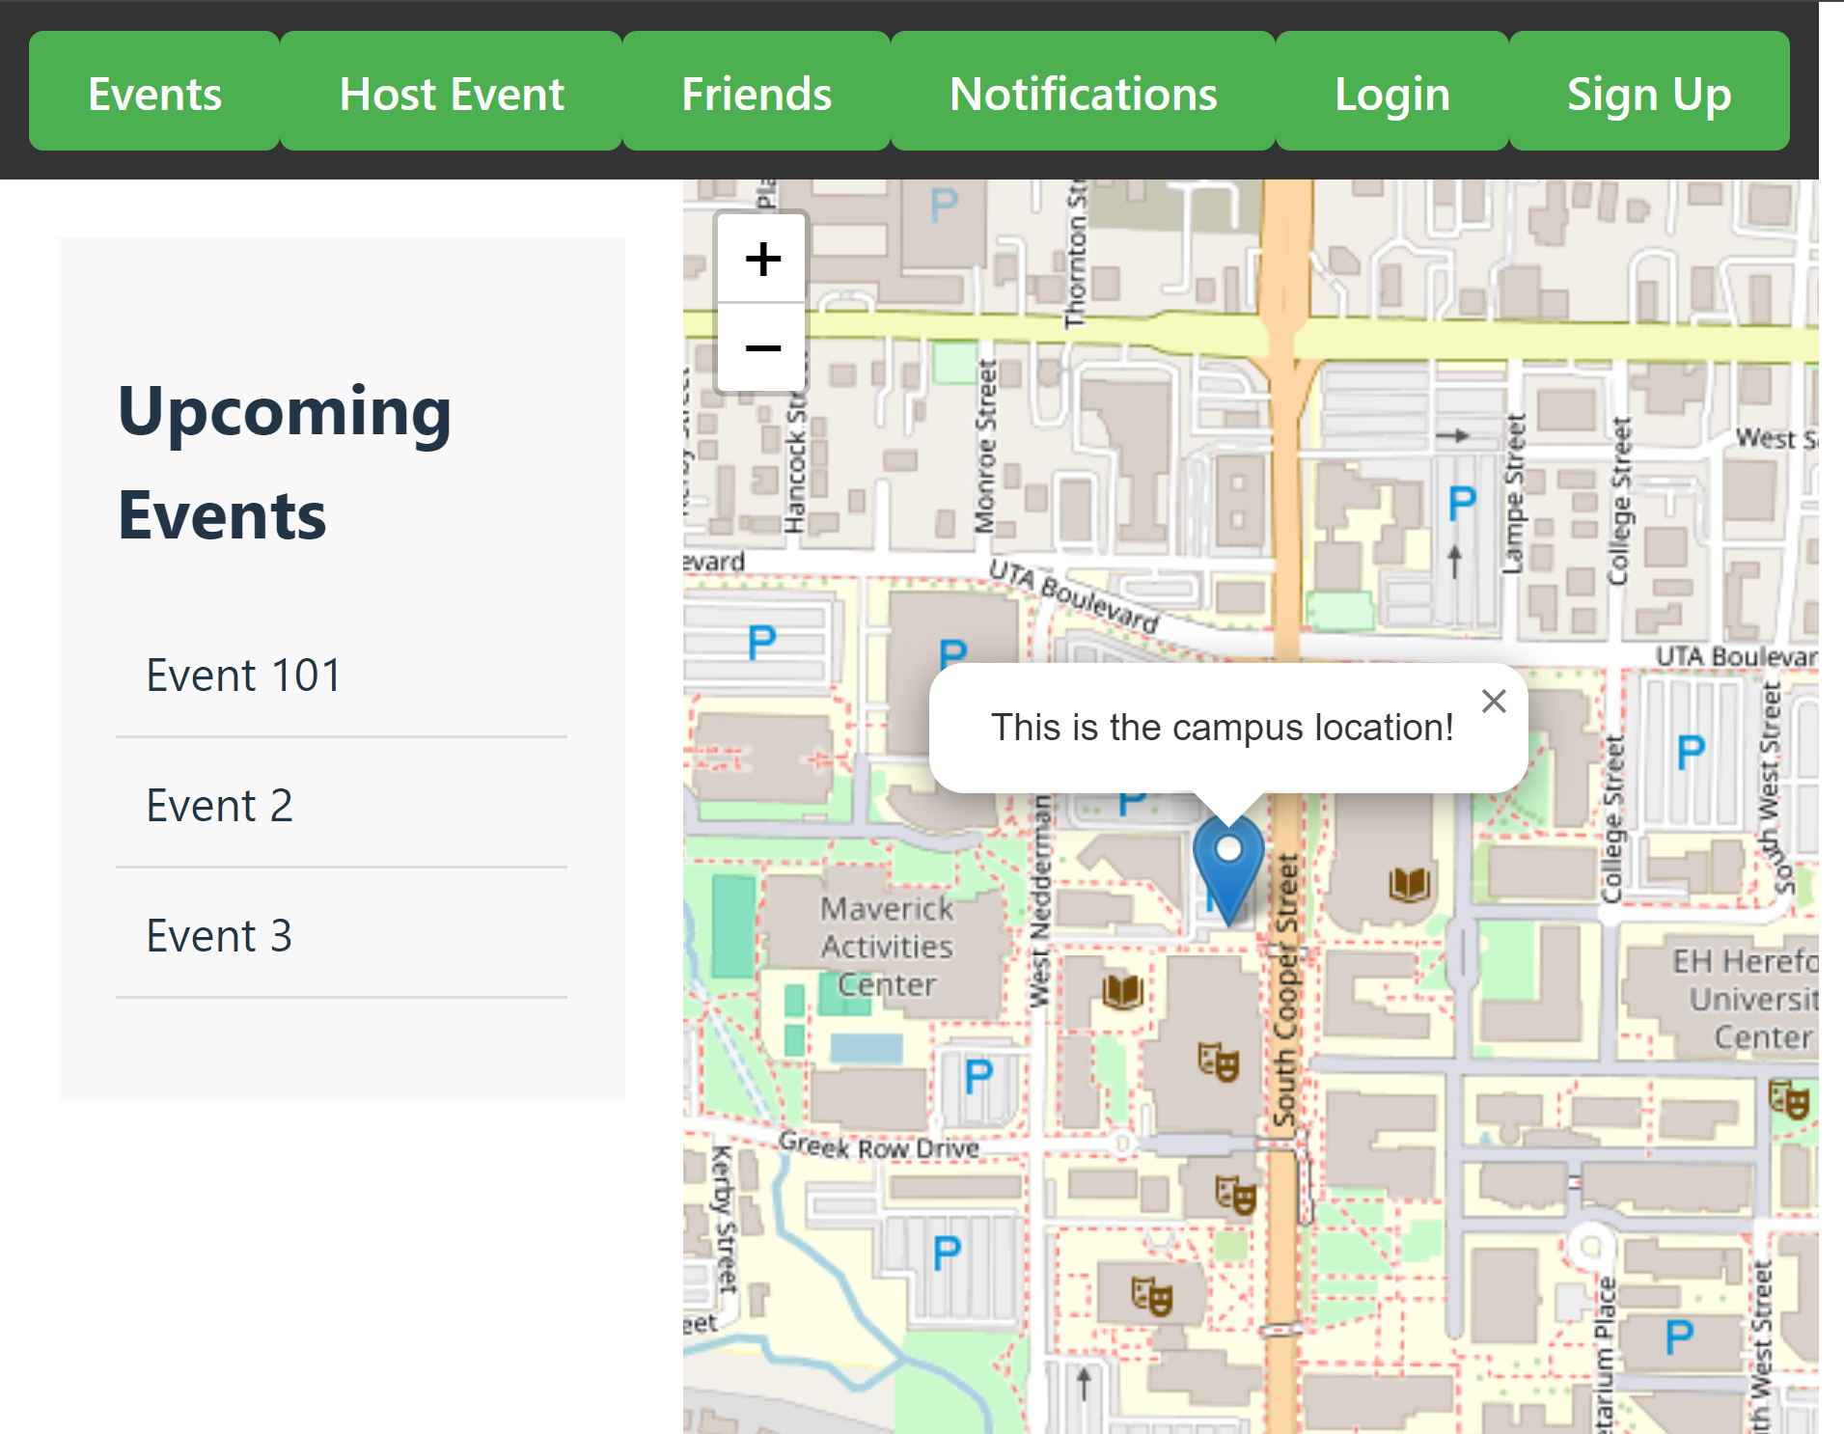
Iteration 1 Screenshot
Check Teams chat for survey link!
Your feedback is highly valued.

Slide 7
Iteration 3 Goals
Finish, test and improve current features
Improve user experience across device sizes
Host Website publicly
Implement Bookmarked Events
Implement Event Filters

Slide 8
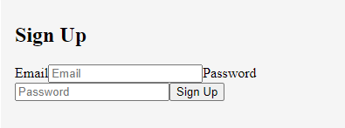
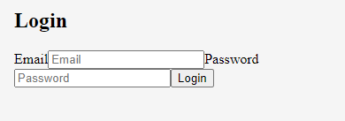
Current Feature Improvement
Login/sign up UI and functions
Build aesthetic and dynamic UI for desktop and mobile
Minimum PW requirements
Account recovery
Determine account restrictions
(UTA only or all visitors? How to control?)

Slide 9
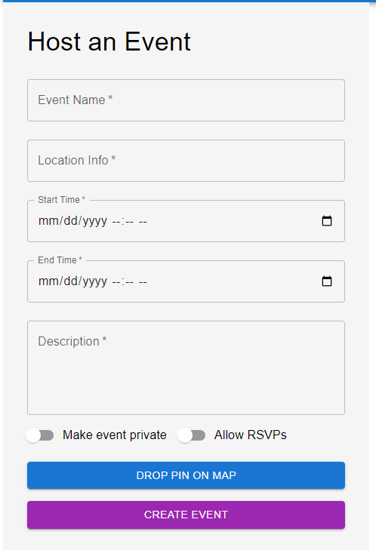
Current Feature Improvement
Host Event back-end functions (private and RSVP)
Private event email invites
External links and controls
Event timeframes and database cleanup

Slide 10
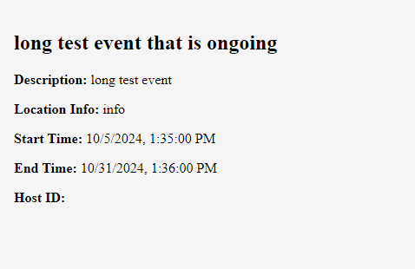
Current Feature Improvement
“View Event” UI and functionality
Build aesthetic and dynamic UI for desktop and mobile
Implement host name
(use real name or email address?)
Implement additional event info (Contact info, external links etc.)

Slide 11
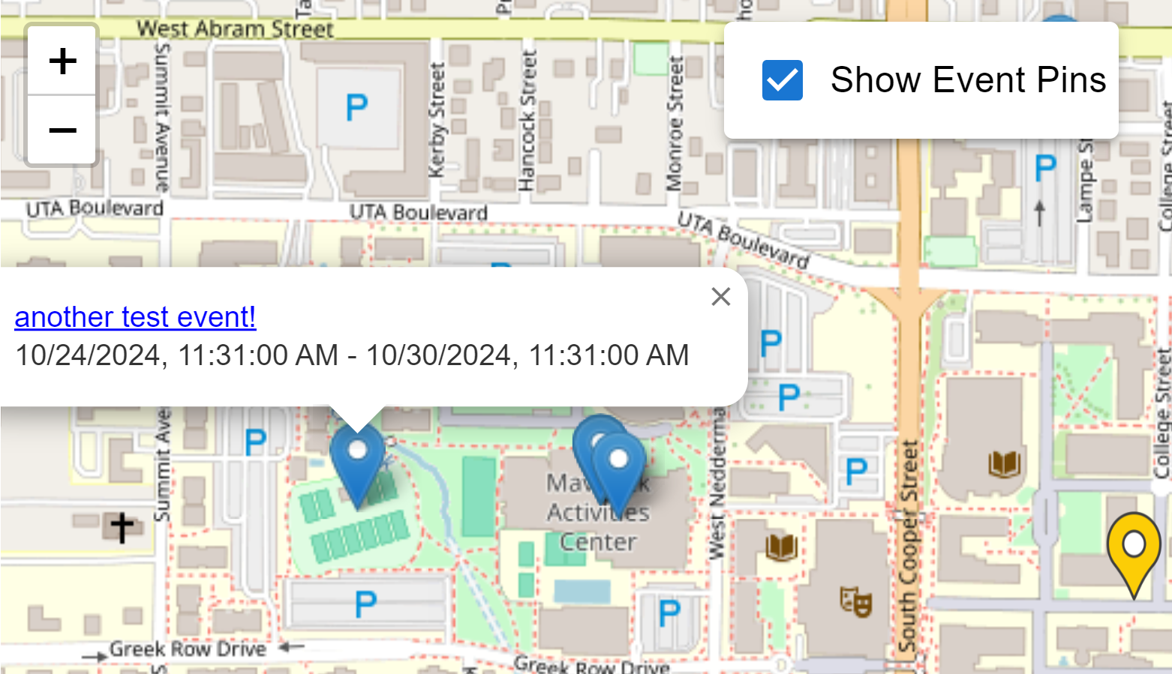
Current Feature Improvement
Fix and improve map user experience
More compact mini info window
Decide default pin visibility
Improve pin highlighting logic

Slide 12

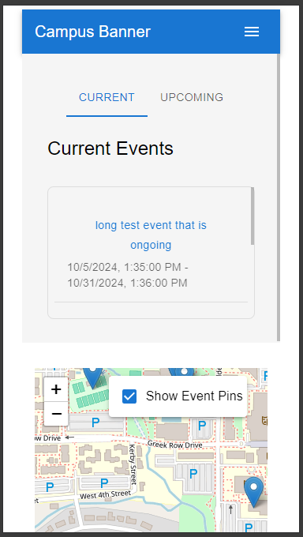
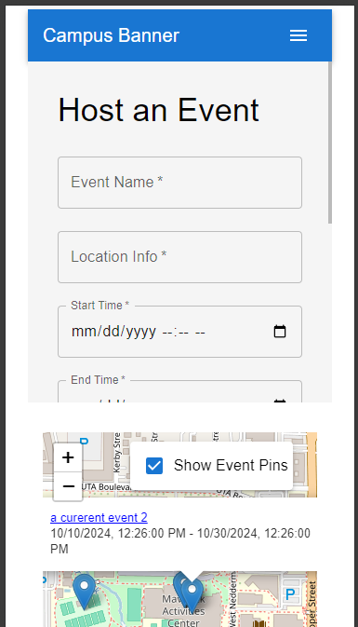
Dynamic Sizing
Improve user experience (UE) across device sizes
Map in drawer or behind content
Test user experience with different configs
Seek feedback

Slide 13

Public Hosting
Initialize hosting with Firebase Hosting
Write and test database rules
Ensure security during development
Initialize hosting

Slide 14
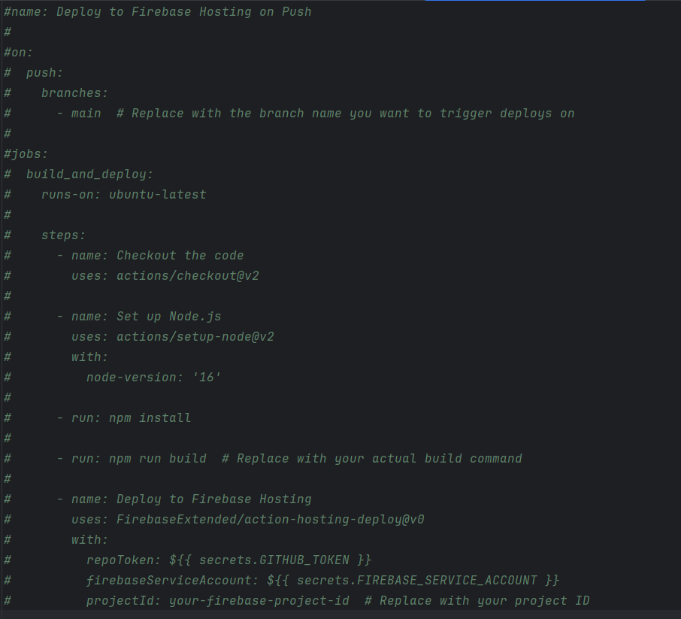
CI/CD
Use Github workflows for continuous integration and continuous deployment
Preview changes with Firebase Hosting Emulator
Github Workflows CI/CD template:

Slide 15
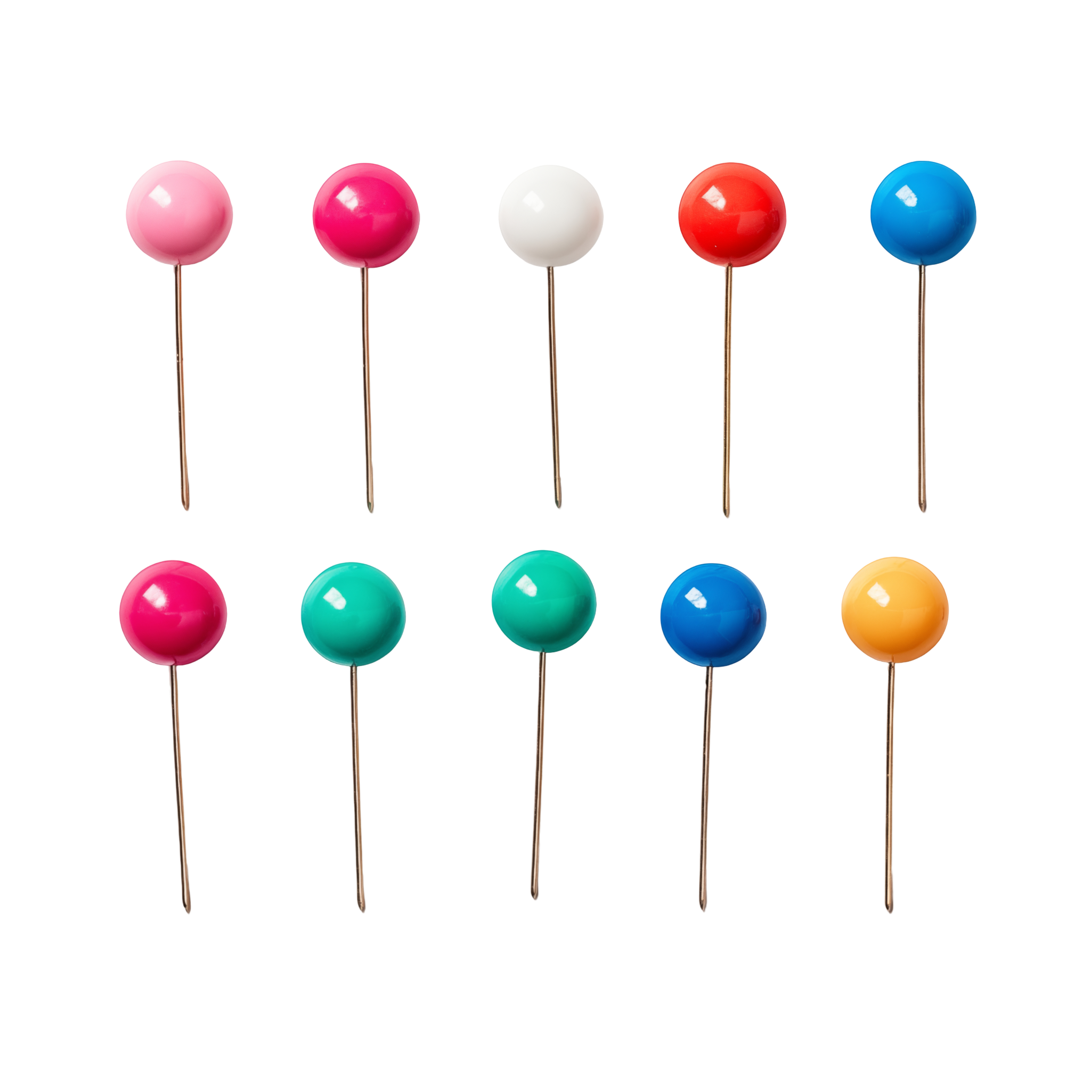
Upcoming Features
Bookmarked Events
  UI similar to event list
  Bookmark an event to find it quickly later
  Events you host are automatically bookmarked for easy tracking
Event Filters
  Events assigned type by host
  Users can filter events they see in event list and on map
  Different map pins for different event types
Attribution: Vecteezy.com

